Slide 1
CS 235101 Data Structures 資料結構
Hashing
Department of Computer Science
National Tsing Hua University

Slide 2
Motivation
Operations in a dictionary
Get, Insert and Delete
Binary search tree
Get, Insert and Delete take O(n)
Balanced binary search tree (AVL tree)
Get, Insert and Delete take O(logn)
Hashing
Get, Insert and Delete take O(1)
Static hashing
Dynamic hashing

Slide 3
Static HASHing

Slide 4
Hash Tables
Hash table (ht)
A container stores dictionary pairs.
Hash table is partitioned into b buckets
ht[0], ht[1], …, ht[b-1]
Each bucket holds s dictionary pairs (slots)
Usually s=1 which means each bucket can hold exactly one pair.

Slide 5
Hash Function
Given a pair whose key is k, the hash or home address of the pair is determined by a hash function, h(k).
Hash function maps keys into buckets by returning an integer in the range 0 through b-1.

Slide 6
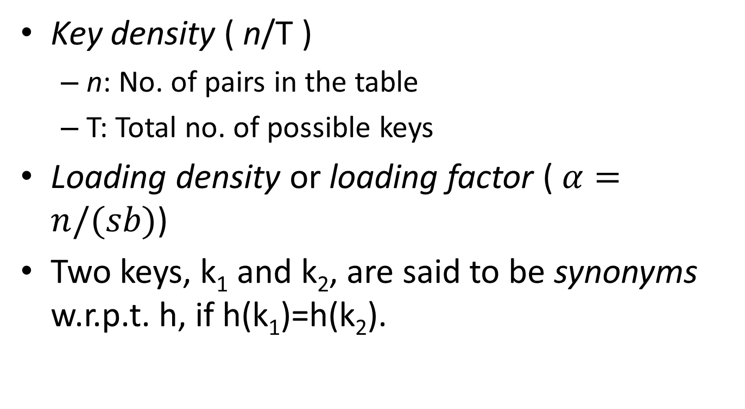
Definitions
Key density ( n/T )
n: No. of pairs in the table
T: Total no. of possible keys
Loading density or loading factor ( $α=n/(sb)$)
Two keys, k₁ and k₂, are said to be synonyms w.r.p.t. h, if h(k₁)=h(k₂).
b: number of buckets
s: number of dictionary pairs each bucket can hold

Slide 7
Definitions
Many keys might be mapped to the same home bucket
Overflow
When a key is mapped to a full home bucket
Collision
When a key is mapped to a non-empty home bucket
Overflow and collision occur simultaneously when each bucket has 1 slot.

Slide 8
Example
Given a set of keys {GA, D, A, G, L, A2, A1, A3}.
Consider a ht with b=26 and s=2.
The hash function maps each key into a bucket using its leading letter.
Represent A – Z as 0 – 25
slot 1
slot 2
0
1
2
.
.
.
25

Slide 9
Example (cont’d)
slot 1
slot 2
0
A
A2
A3
A4
1
2
GA,
D,
A,
G,
A2
A3
A4
3
D
4
Collision
Overflow
5
6
GA
G
.
.
.
25

Slide 10
Hashing Properties
If the no. of slots is small, all operations (search, insert and delete) can be performed in O(1).
Using leading letter is not a good hash function.
Keys might bias toward certain buckets.
A good hash function should be
Easy to compute
Result few collisions

Slide 11
Uniform Hash Function
A hash function that dose not result in a biased use of the hash table for random keys.
Given a key k chosen at random, we want the probability that h(k)=i to be 1/b for all buckets i.
Four popular hash functions
Division
Mid-Square
Folding
Digit Analysis

Slide 12
Division
h(k) = k % D
Keys are non-negative integer and the home bucket is obtained by using the modulo (%) operator.
Bucket address range from 0 to D-1, so the hash table must have at least b=D buckets.
Using a prime number for D (see textbook).

Slide 13
Mid-Square
Squaring the keys.
Use an appropriate number of bits from the middle of the squared key as bucket address.
If r bits is used, the size of the table is 2^{r}
If there are 64 buckets ( 2⁶ ), we need middle 6-bits to determine the bucket address

Slide 14
Overflow Handling
Open addressing
Linear probing
Quadratic probing
Rehashing
Random probing
Chaining

Slide 15
Linear Probing
0
A
Find the closest unfilled bucket.
To insert a key k.
Compute h(k).
Check the hash table buckets in the order ht[h(k)], ht[(h(k)+1)%b], …, ht[(h(k)+j)%b] until an empty bucket is found.
If no empty bucket is found, double the size of ht.
e.g. GA, D, A, G, A2
1
A2
2
3
D
4
5
GA
6
G
7
8
9
.
.
.

Slide 16
Linear Probing
Searching for a key k.
Compute h(k).
Examine the hash table buckets in the order ht[h(k)], ht[(h(k)+1)%b], …, ht[(h(k)+j)%b] until:
ht[(h(k)+j)%b] has the same key. Found!
ht[(h(k)+j)%b] is empty. Not found!
Go back to starting point. Not found!
Disadvantage:
Keys tend to cluster together.

Slide 17
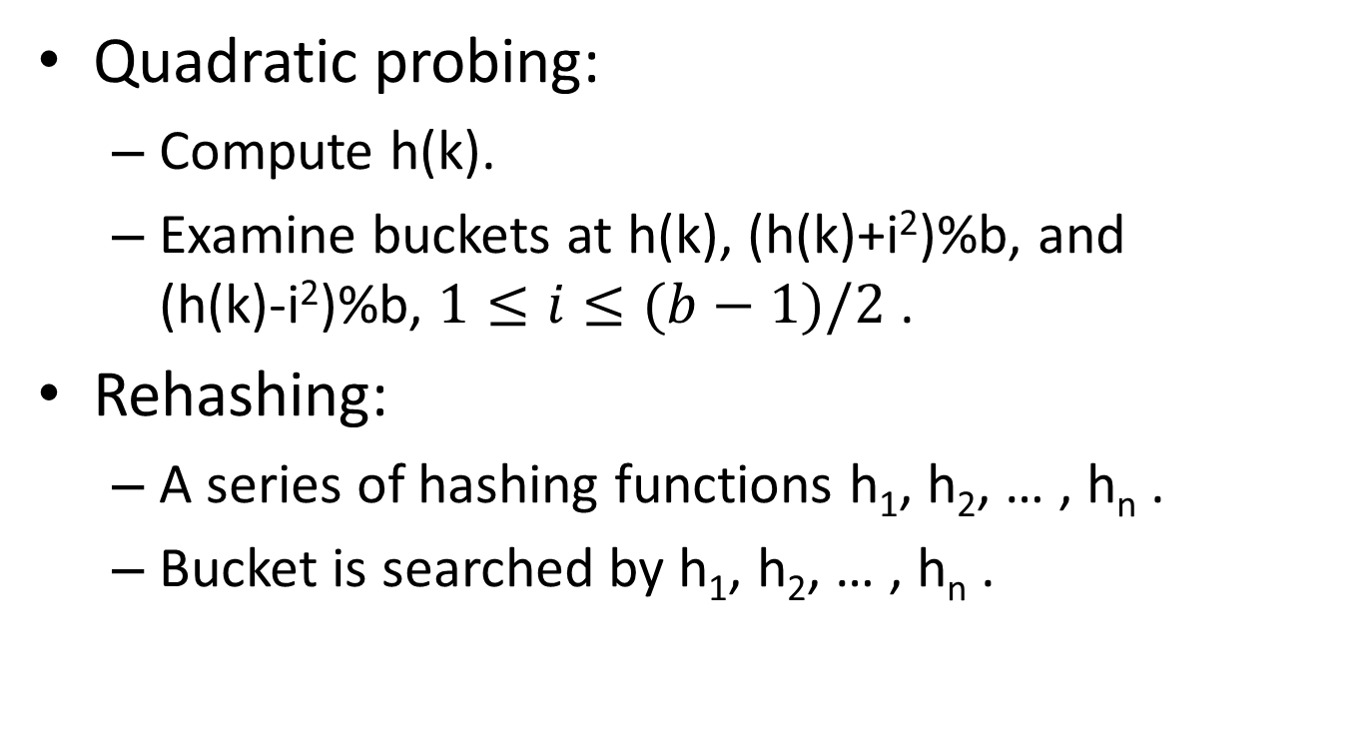
Others
Quadratic probing:
Compute h(k).
Examine buckets at h(k), (h(k)+i²)%b, and (h(k)-i²)%b, $1≤i≤(b−1)/2$ .
Rehashing:
A series of hashing functions h₁, h₂, … , h_{n} .
Bucket is searched by h₁, h₂, … , h_{n} .

Slide 18
Chaining
Use chained hash table to solve collisions
Each bucket holds a list of keys (key chain)

